Slide 1
Diwali 2021

Slide 6
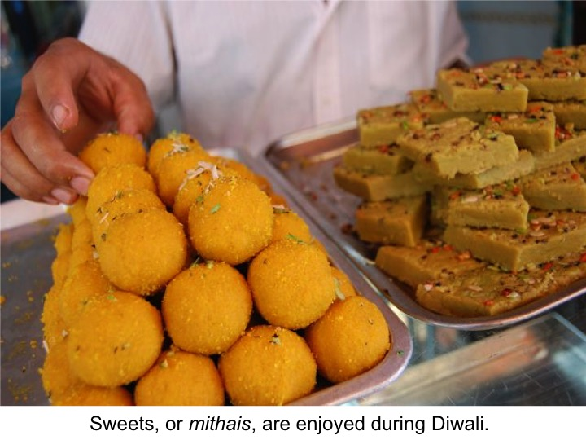

Slide 7
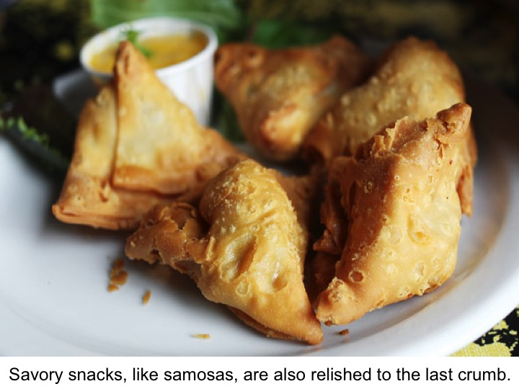

Slide 8
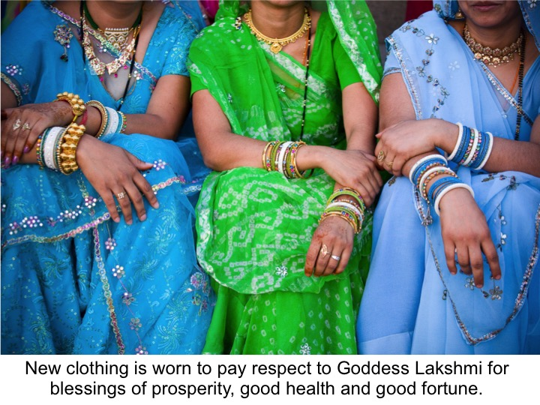

Slide 9
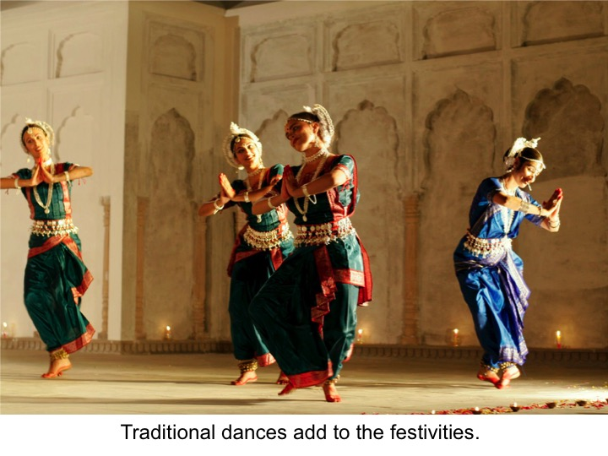

Slide 10
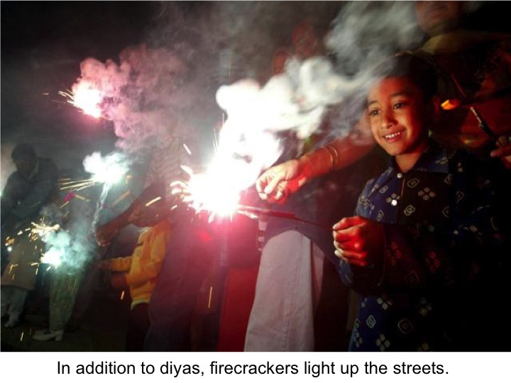

Slide 11
Add your family photo here

Slide 12
Resources:
Diwali Toolkit: https://www.hinduamerican.org/diwali-toolkit
Diwali Resolution: https://www.hinduamerican.org/wp-content/uploads/2020/10/Draft-Diwali-Resolution-2020.pdf
Diwali Resolution Request Email: https://www.hinduamerican.org/wp-content/uploads/2020/10/DIWALI-RESOLUTION-REQUEST-EMAIL-TEMPLATE-2020.pdf
Hindu Speakers Bureau Diwali 2021 Instructions: http://hinduspeakers.org/diwali2020/
Hindu Speakers Bureau Educational material: http://hinduspeakers.org/educational-material-on-hinduism/
A video guide by one parent: https://www.facebook.com/watch/?v=2198338486860738

