Slide 1
Hinduism Basics
Place
Date
Presenter
Notes:
Thanks so much, Nathan, and to the Middle Tennessee School of Anesthesia for having me here today! I’m very excited to talk about this topic with you—about Hinduism and Medicine.

Slide 2
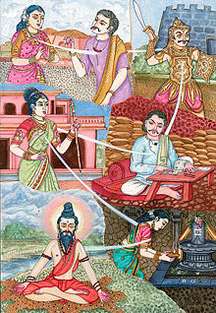
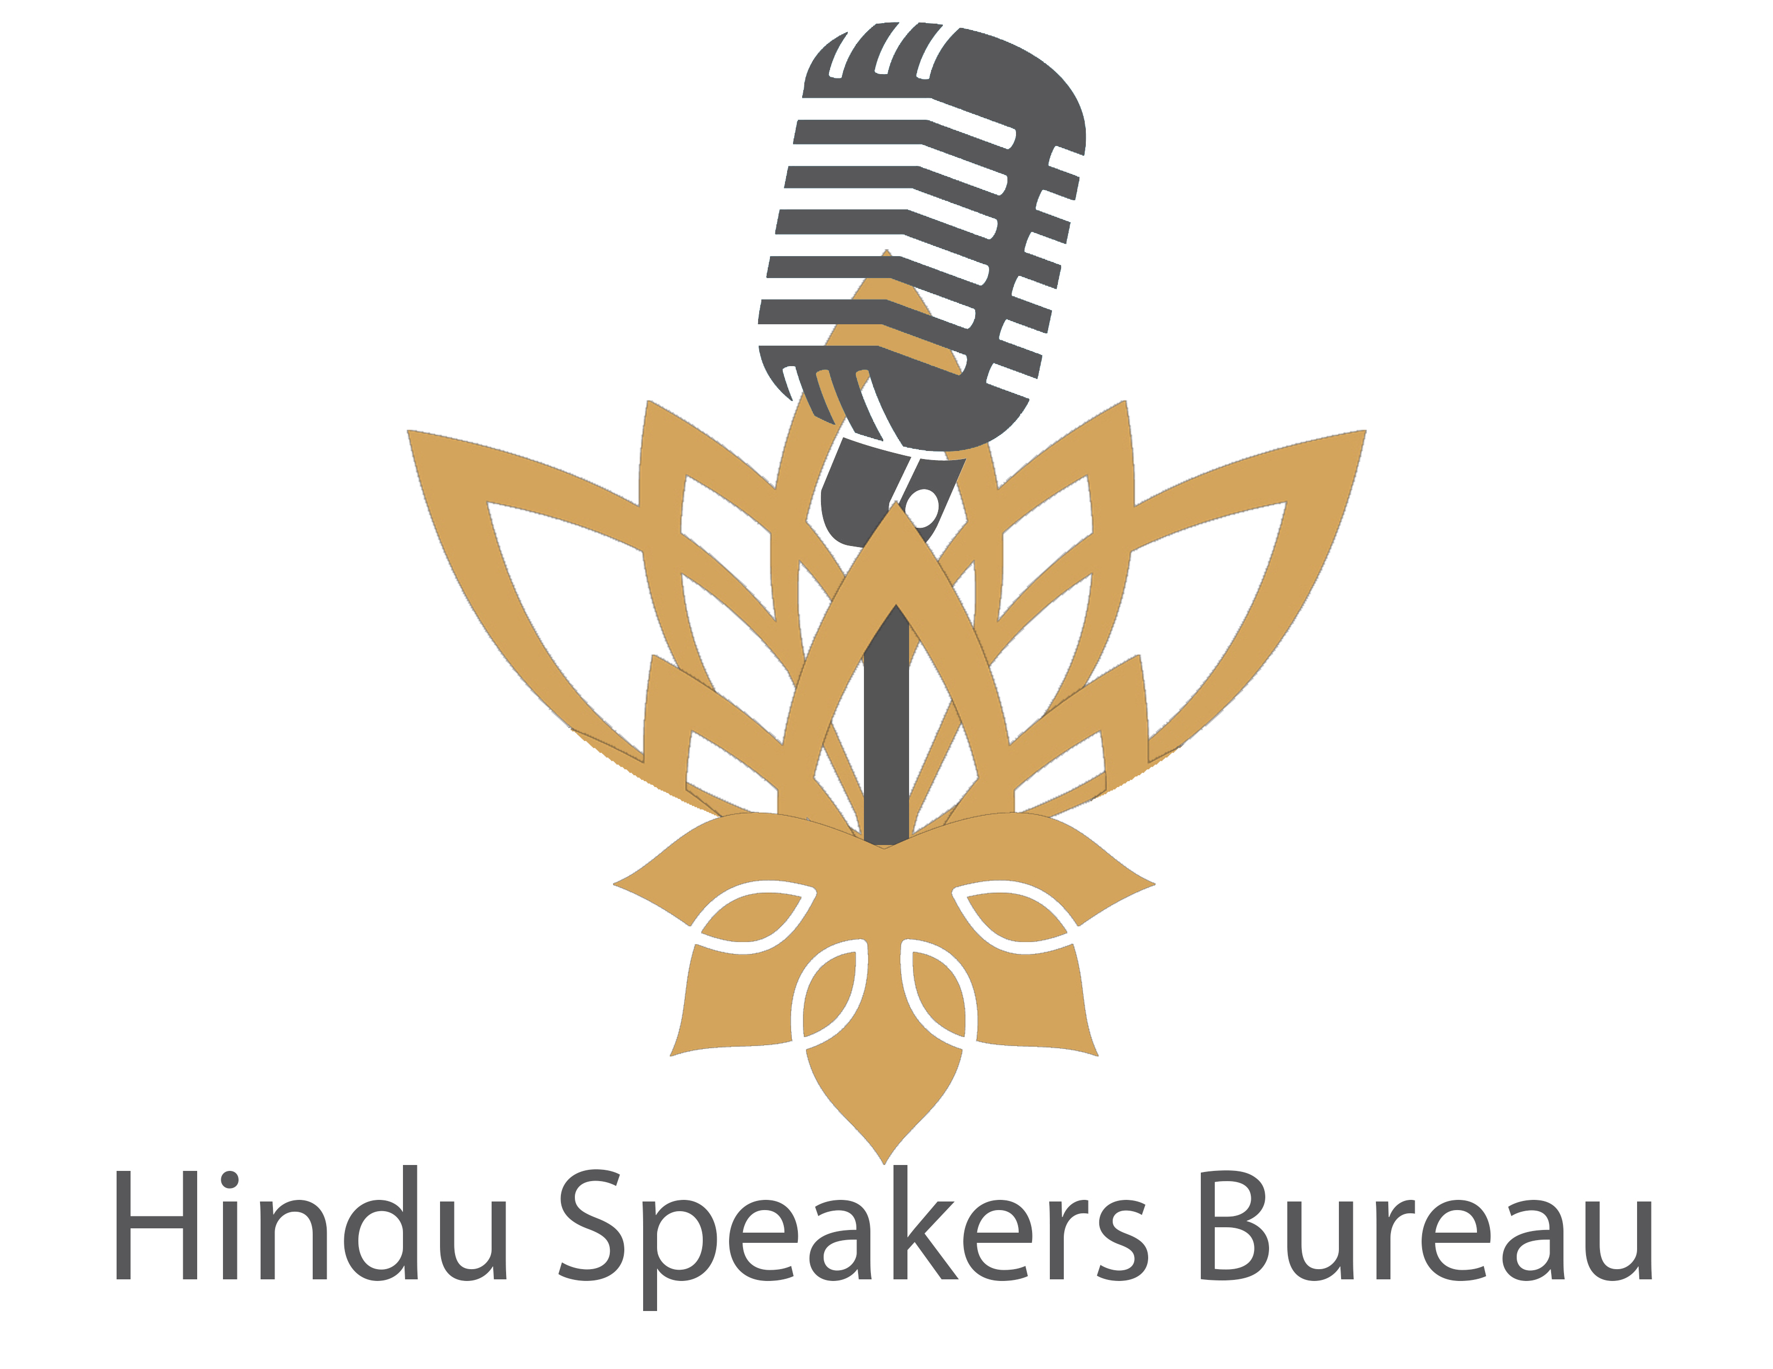
Hinduism Basics
Karma and reincarnation
All actions have moral consequences
These bear fruit in this life and future lives
Adhering to one’s dharma
Hindu patients may also see illness as their karma (phala)
Hindu patients may also speak of the next life
Notes:
Now a quick word on reincarnation – the idea here is that all actions have consequences. Those consequences are physical, emotional, intellectual, and moral. Actions can bear fruit right away, but they also sometimes get planted and only sprout in the next lifetime. By adhering to your dharma you can limit bad fruits and attain the good fruits of that action. Now, for your Hindu patients, some may speak of illness as the fruit of their Karma—or think this, but not tell you. An equivalent expression in the Christian framework may be “It’s my cross to bear”. As always, there are subtle differences. CLICK moreover Hindus may be thinking about the next life, though I wouldn’t overweight this.

Slide 3
Hinduism Basics
Hindu Values:
Satyam – Truth
Ahimsa – Non-Injury/Non-Violence
Danam – Charity / Giving of one’s self
Vairagya – Detachment
Sthita Prajnya – Fixedness in wisdom
Sanatana (Eternal) Dharma (Duty)
Sometimes used as a synonym for the exonym Hinduism
Notes:
Moving on, so if you want to do good and minimize the bad you do—how do you do that? Well, these are important Hindu values. I should emphasize that some of these (colored in red) are universal values, or recognizably universal; some are a little more unique and thus interesting to students of religion and also to those taking care of patients, in blue. And then some are a mix. So in the Hindu perspective, of course there is a value for Truth—the highest ideal—not just speaking it, but trying to find it—like for example how many of you are interested in research? Same animating value, to find what’s true. Least injury—this is a value for non-violence or least injury. It’s considered the highest dharma, which is interestingly distinct from the highest ideal—and you all have taken this vow yourself, primum non-nocere. Charity is an outgrowth of the same. Then there’s dispassion/detachment, which is a prime method of achieving fixedness in wisdom—the person who is unmoved by the waves of life.
So following all of these values and figuring out what to do when they conflict is part of doing one’s unchanging, eternal (Sanatana) dharma. Hindus will sometimes use this term as a synonym for their religion, since Hindu is an exonym by way of the Sindhu river (same as India).

Slide 4
Hinduism Basics
Paths to Moksha
Bhakti Yoga - The path of Devotion
Jnana Yoga - The path of Knowledge
Karma Yoga - The path of Action
karmaṇyevādhikāraste mā phaleṣu kadācana। mā karmaphalaheturbhūrmā te saṅgo'stvakarmaṇi॥
You have the right to work only but never to its fruits. Let not the fruits of action be your motive, nor let your attachment be to inaction.
Notes:
So how do you achieve something like happiness eternal? Highest goal, toughest to reach. Well, over the millenia Hinduism has evolved these primary 3 paths. There is the path of devotion—purification through prayer. There is the path of knowledge, study of scripture to remove the wrong understandings that prevent us from seeing the Soul as it truly is. And the path of action—becoming the kind of fixed in wisdom person who can take dharmic action without being attached to the results. The quote is from the Bhagvad Gita—one of the most famous and widely-read of all the Hindu scriptures.

Slide 5
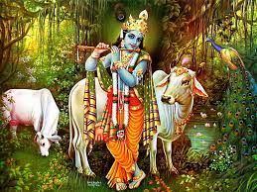
Hinduism Basics
Sacredness of all living things
Ahimsa Paramodharma
Basis of vegetarianism
Notes:
Just because it is considered the highest duty—paramodharma, paramount if you will—another line on Ahimsa. The least harm you can do, the better. This is the basis for the large number of Hindus (though still a minority!) who are vegetarian, and the larger number (probably a majority) who don’t eat specific meats—many draw the line at beef, some at other mammals, etc. If you hospitalize patients, or work with them on a diet, you’d want to know these things. Additionally, and it is IMPOSSIBLE to generalize—please ask!—you may see some resistance to very invasive interventions at the end of life. You may see also slightly more acceptance of the inevitability of disease and death. Again, this is VERY variable!s

Slide 6
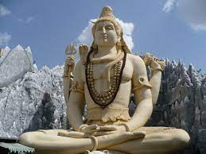
Hinduism Basics
Yoga, meditation
Pathways to not just physical but spiritual health
Methods of “tuning the mind”
Ongoing research regarding health benefit
Very tough to do non-confounded trials!
Some benefit in depression, etc.
Warning in specific neurologic/muscular scenarios:
Axial loading/twisting
Inverted positions
Notes:
Now, Yoga. Yoga is a key physician/mental/spiritual practice—note NOT just physical—for centering the body and calming the mind, ultimately for attaining Moksha. You all may have seen that there are trials of Yoga for various diseases, with some sign of efficacy in depression, etc. But like anything that is effective it must be risky in some populations, right? Well, at least when I slipped a disc myself the Neurosurgeon suggested I avoid Yoga for at least 6 months due to the axial load from all the “BLT” (Bending lifting twisting). And not to stand on my head. But Hindu patients may be doing Yoga without thinking much of it, so you might consider asking. Though of course non-Hindu patients do Yoga too. Like with anything else, you’ll want to negotiate this.

Slide 7
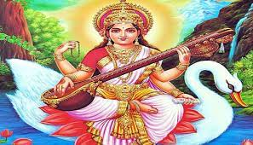
Hinduism Basics
Value for learning and knowledge
Hindus don’t like to put their feet on books
Notes:
One other thing about Hinduism is that there is a deep value for learning and knowledge. This image is of the feminine divine in one of my favorite forms—Saraswati the Goddess of Wisdom. The value for knowledge manifests in obvious ways—pursuit of college education, being gunners in medical school☺--but also in less obvious but more visceral ways. So for example, many Hindus grow up—like me!—knowing not to touch books with their feet. Every so often this may create distress if you need a step stool or something to brace the foot—definitely don’t use a book for this purpose! They may also “apologize” to the book if you do, which they may do by touching their hands to it and then to their heads. Moreover, they may hold this attitude for musical instruments as well—notice that while one hand is holding an ancient Hindu book (L lower hand), 2 of the 4 hands hold a musical instrument. So, don’t use books to prop up a foot or leg if you can help it!

Slide 8
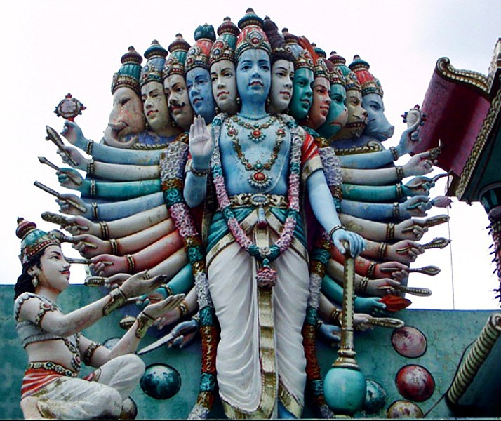
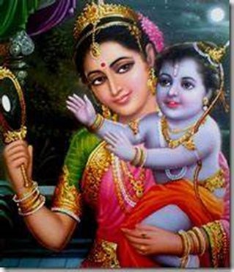
Hinduism Basics
Monotheistic vs. Polytheistic
saguna vs. nirguna brahmana
Notes:
OK, so, now on to some misconceptions. I alluded to one of the first things people ask about—is your religion Monotheistic or Polytheistic? Well, naming two gods—Shiva, Yama—in the first slide, you’d think the answer was obviously polytheistic. But this distinction is a less useful one in Hinduism. Here’s what I mean: In Hinduism we accept two different aspects of brahmana, or God—Saguna, with attributes; and Nirguna, without attributes. This means that God can be visualized, manifested, and experienced as Lord Shiva or, as you see here, as Lord Vishnu, the protector/preserver of creation. However, She/He/It/They have a form that is also totally without attributes. Colorless, shapeless, without texture, subtle beyond the words I am using. The more spiritually developed, the subtler the experience, up to a level that transcends human limitations. So there are several levels of understanding that divinity. So, when Lord Vishnu was asked by the hero warrior Arjuna (SEE HIM HERE) to show his true form, Lord Vishnu took this Vishwarupa form—the number of heads and arms is symbolic of the overwhelming infinities that Arjuna then beheld. You can see whole planets revolving near his feet. Arjuna could only look for a moment and then asked Vishnu to go back to looking like a human being, it was too much to see this divine form.
CLICK Here’s another example, one of my favorites. This is Vishnu as the Lord Rama Avatar, that is a manifestation of the Divine energy in corporeal form. See, not just for the Sims and originally from Hinduism! Well, when Rama was to be born, Lord Vishnu appeared to the woman who would be his mother for that birth—Kaushalya—and asked her what would help her accept him as a child. She said, “I can’t fathom you in this form—pretend to be a child so I can love you as a child.” The verse that immortalizes this conversation is one many Hindus chant at each birth and in some cases at each birthday. Are any of you parents? Maybe some of you will recognize the indescribable joy that can attend that moment—though sadly not all are so fortunate, especially during these COVID times—and this verse tries to capture that recognition that each child is a form of the lord being made anew.
CLICK so in the end, Hinduism doesn’t really distinguish between monotheism and polytheism, rather the Lord can manifest in many ways, as part of the complex illusion or simulation that is reality. That said, we live in America, and your Hindu patients may well use/adopt mono-language. Many/most Hindus speak of God singularly, and will also sometimes refer to God as a given form as I have been doing, and this makes perfect sense to us!

Slide 9
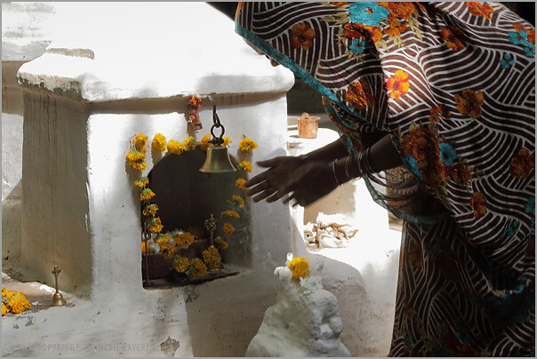
Hinduism Basics
Murti puja
Symbolic of welcoming a guest
Common practice at home & temple
You may see Murtis at a Hindu home
Notes:
Another aspect of Hinduism: “Idol worship”, or as we refer to it, Murti Puja. Some words just don’t translate well. CLICK Here you see a woman in India praying prior to her workday. The key thing is CLICK she worships the lord through this image, and treats it almost like a revered guest—inviting the Lord into her home or temple, washing her/his feet, giving flowers, giving food, singing to/entertaining the guest, and then letting her/him return to the divine abode.
CLICK This is actually one of the most common practices in Hinduism, but you may not encounter it much b/c it is somewhat private. CLICK However, if you do a home visit, you may see Murtis, especially in a specific part of the house dedicated to this.

Slide 10
Hinduism Basics
“The world is one big family”
“The truth is one, but the wise call it many names”
“Let noble thoughts come to us from all sides”
Notes:
I will end with the pluralistic nature of Hinduism, which I think may help contextualize what I’ve already told you. Exhortations in our scriptures include these three statements, which in my experience Hindus—including me!—never get tired of quoting. The world is one big family—no us and them. There is truth out there, but it may be seen differently by each according to their own experiences and knowledge. And finally we should be open to good ideas from anyone. I think this last in particular explains why Hindus will tend to be additive, not substitutive. If you give them a medicine, they’ll take it; if they later get another medicine etc. from an Ayurveda practitioner, they will take that too. If they do CAM, it will be C not A.

Slide 11
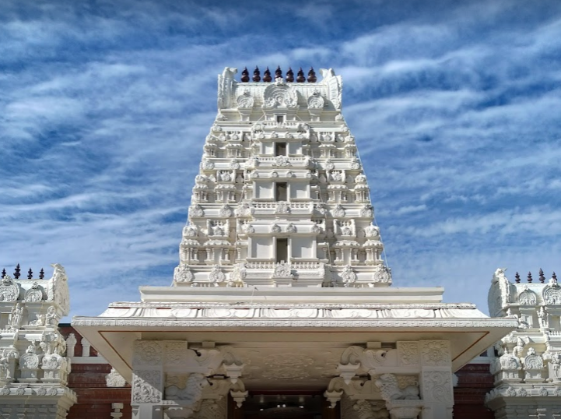
Hinduism in America
Hindus in America
0.7% of the population
Mostly Gen X/Millenial (young pop – 1965+)
Mostly South Asian immigrants… but not all!
Notes:
Now that you know all this, here are some specific things to know about Hindus in this country! Some of you may do rotations abroad in global health, but most of you will take care of patients in the US and that’s what I’m going to cover. (Also, for something as rich as India—if you will encounter it, better you learn about it directly.) You should know that Hindus are a VERY specific population in the US. There are not that many of us, but the numbers are growing slowly mostly due to immigration. The Hindu community in the US mostly originates (with a few exceptions) in the immigration reforms of 1965. Mostly we are either South Asian immigrants or the children of these, but there are important populations that are NOT South Asian, including a body of converts especially Hare Krishnas, and a several large and vibrant non-SA populations such as Hindus from the Caribbean or Fiji.

Slide 12
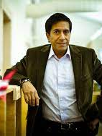
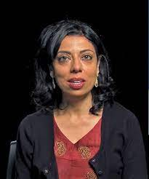
Hinduism in America
Hindus in America
Highly educated (almost 77% college+, vs. 33% mainline Protestant)
Well off (70% $50K +/yr, vs. 51% mainline Protestant)
Lots of them in Health Care (self-explanatory)
https://www.pewforum.org/religious-landscape-study/religious-tradition/hindu/
Notes:
They tend to be highly educated—among the most educated of ANY religious group, see the comparison to mainline protestants. (Parenthetically, this is always a sobering reminder to me that the vast majority of Americans do NOT have a college degree!). They have a high measure of personal wealth, the highest of any “group” other than Jewish people (CITE). And, you may have noticed, there are a LOT of them in healthcare! (Sanjay Gupta, Atul Gawande, Monica Gandhi, Vivek Murthy, etc. Plus the ones you know IRL.)
But there are MANY Hindus who may be less well off as well. Don’t assume things about anyone!

Slide 13
Hinduism in America
Hindus in America
In general speak English very well
Fairly liberal on:
LGBT issues (71% accept it; 68% favor same sex marriage)
Evolution (79% it happened)
Abortion (68% legal)
Etc.
Mainly not many chaplains around
You can offer a Bhagvad Gita if one is available
https://www.pewforum.org/religious-landscape-study/religious-tradition/hindu/
Notes:
So what does this add up to? Hindus in America are largely a “cream skimmed” population. That is, they are people who wanted to immigrate to America ever since the 70s, largely to supplement labor roles that were in semi-short supply—so with advanced degrees, MDs or engineering, etc. In the Indian context, this also means English-medium education for many/most. So in general they speak English very well, certainly well enough to get by. They are fairly liberal on most social issues – you can see some of the numbers

Slide 14
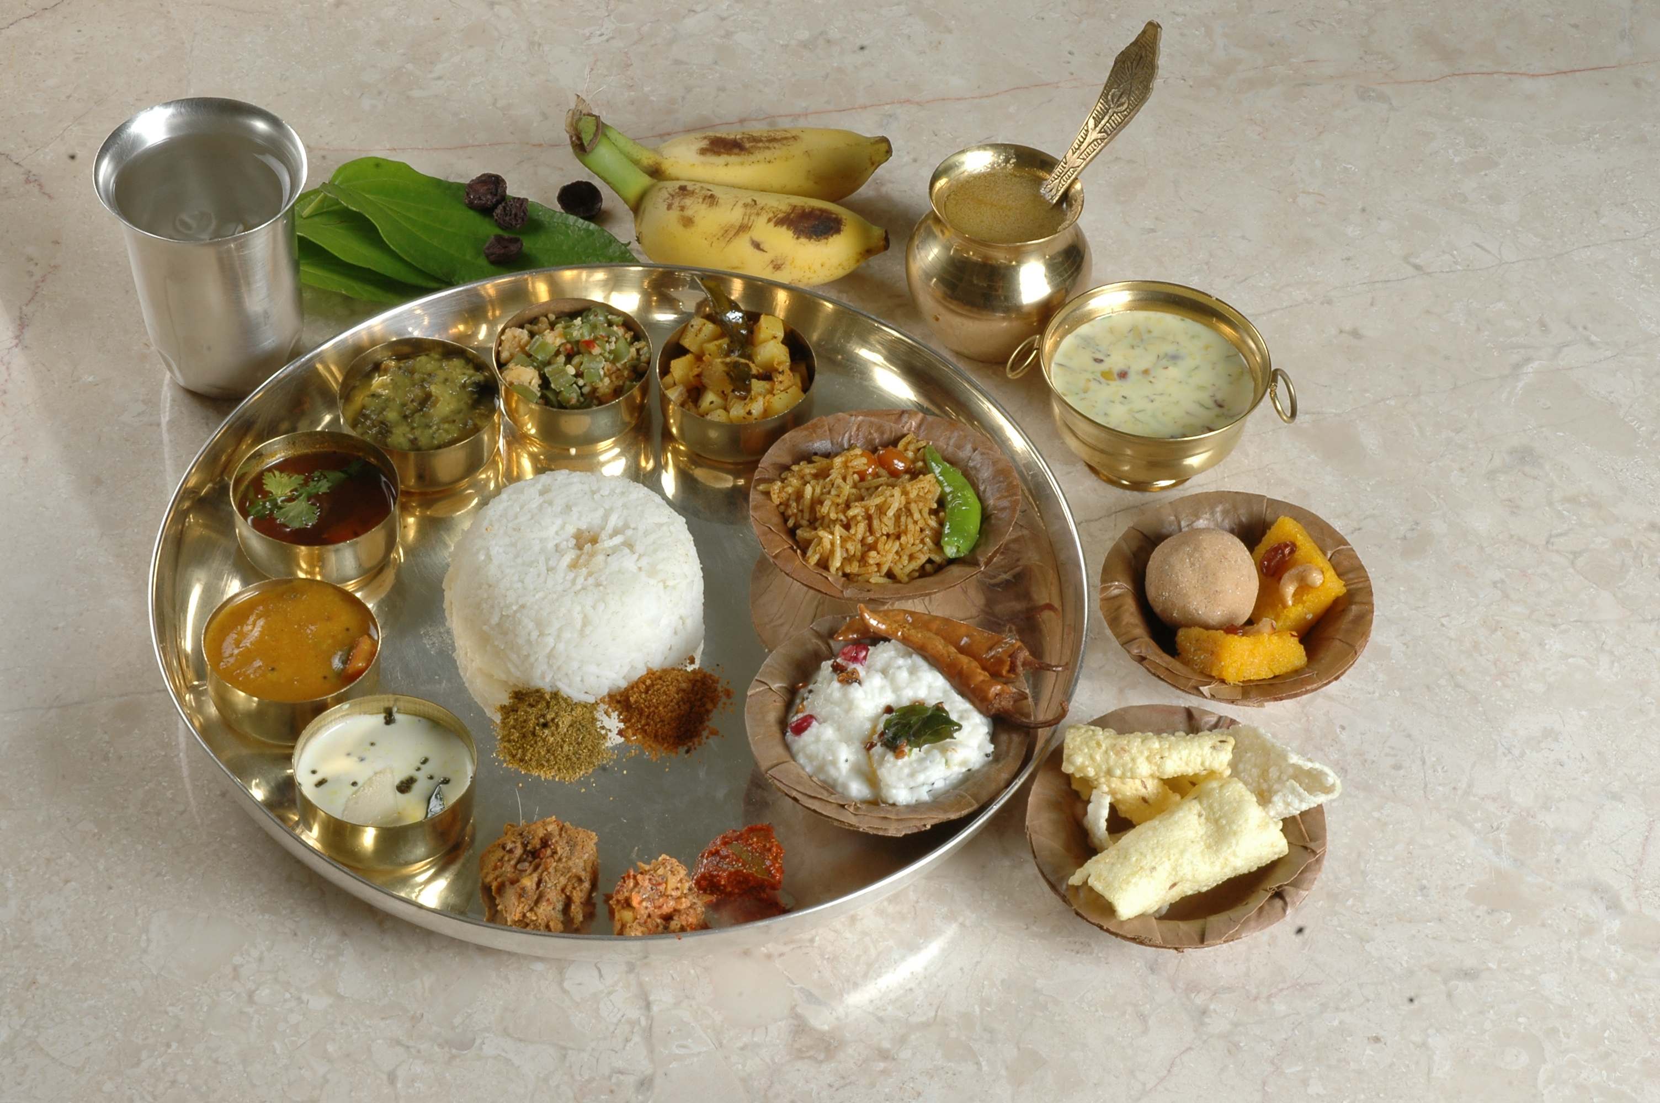
The Hindu
Diet/Dietary
Notes:
What to say about diet? First, you won’t know till you ask. Hindus range from strict Lacto vegetarians (and in some cases vegans) to all meat, though the majority will probably reject beef. They distinguish between eggs and milk. But more importantly, the food itself tends to be different—rice is important, unleavened bread is important, vegetable curries tend to be important. I’d say this is true of all ethnic groups—you have to work within the diet that’s eaten, and you can find healthy options there.

Slide 15
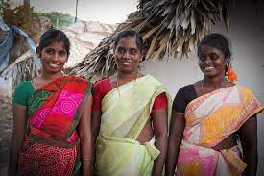
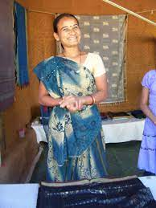
The Hindu
Clothing
Notes:
Clothing varies massively among Hindus. Just for one example, the traditional Hindu outfit is the Sari, which can be bloused or blouseless, the free part (Pallu) in front or in the back, etc. This has very little to do with Medicine but just for your cultural awareness—there are countless variations. Hindus will tend to want some form of modesty, but will not in general restrict you from certain physical exam maneuvers. However, you may want to break the ice and say, “I know this may be uncomfortable, but I am going to examine you now—I may have to …” and they will mostly be game. There is no religious restriction on that.

Slide 16
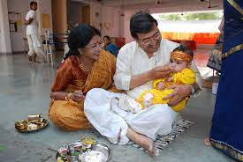
The Hindu
First rites
Notes:
Like most religions, Hinduism has a wide variety of variably observed rites from birth—in fact even before birth during pregnancy—to death. As soon as I was born, my father wrote the sacred symbol “Om” on my tongue. I did the same with all of my children. But this ceremony you see is the Anna Prashna—literally first presentation of food.
One other minor note—circumcision. Feel free to offer it, but don’t pressure. Circumcision is not part of the Hindu religious practice, though many Hindus may have been/may agree to circumcision if the benefits/risks are explained.

Slide 17
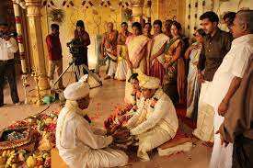
The Hindu
Family Involvement
Notes:
OK, so the Hindu family. It’s often big, extended, usually or often very close knit. (this is a Hindu wedding BTW) Lots of people, lots of opinions. This is not too different from immigrant families in general, but may be different from families with a longer pedigree in the US. You may get a LOT of visitors!

Slide 18
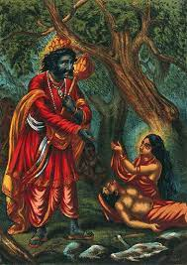
The Hindu
End of Life
Notes:
So I started this talk with a story about Yamaraj—the God of Death. Interestingly, he is not the villain in any of the stories about him—though in the story I related he yielded to Lord Shiva, in another story he plays a benign role in blessing a wise young woman and granting her husband a reprieve; in another he actually teaches some of the most sublime wisdom to a young boy who has come to him as a sacrifice. The point is, the relationship with death is not one uniformly of fear or hatred. Death is inevitable. No Hindu rushes towards it or desires it, not any more so than any other religion; but there is definitely more fatalism about it. This MAY mean, for many but not all Hindus, that palliative care is more OK: DNR/DNI are more OK; etc. But you won’t know till you ask!

Slide 19
The Hindu
Last rites
Notes:
Last Rites in Hinduism can be very involved.
One thing Hindus—especially immigrants—find very odd is how long sometimes passes between death and cremation. In India, typically within ONE DAY the body is cremated. If you’re the son, daughter, wife, husband, whatever, and you don’t make it in time, that’s too bad. In this country, the sometimes 3-4 days of delay can be offputting—but if you explain it or know that it’s different, you can usually lead with this—”I know this is unusual, but we often do keep the body for X Y Z”. Relatedly, I wouldn’t modify your request/approach to autopsy—just recommend it if you think it appropriate and explain your rationale. People may or may not say yes.

Slide 20
The Hindu
https://www.hinduci.org/last-rites-guidance.html
Notes:
As with any other community, whenever a patient dies, things are happening in parallel along many axes. This excellent schema from the Hindu Community Institute shows the family vs. Religious vs. Medical things that are happening and helpfully juxtaposes them temporally. Note the tail end of this goes on for a very long time. But I also want to emphasize that whatever rituals are done or are possible, the underlying belief is this one from the Bhagvad Gita. Don’t assume that your patients hold it, but religious Hindus may and it is a source of comfort to them similar to that of other religious people who believe in an indestructible, eternal soul.

Slide 21
Wrap Up
Hinduism is a pluralistic, varied religion→the pursuit of happiness*
Hindus are small, highly educated, wealthy community in the US*
Hindu will in many respects resemble other immigrant patients*
Questions?

